Slide 1

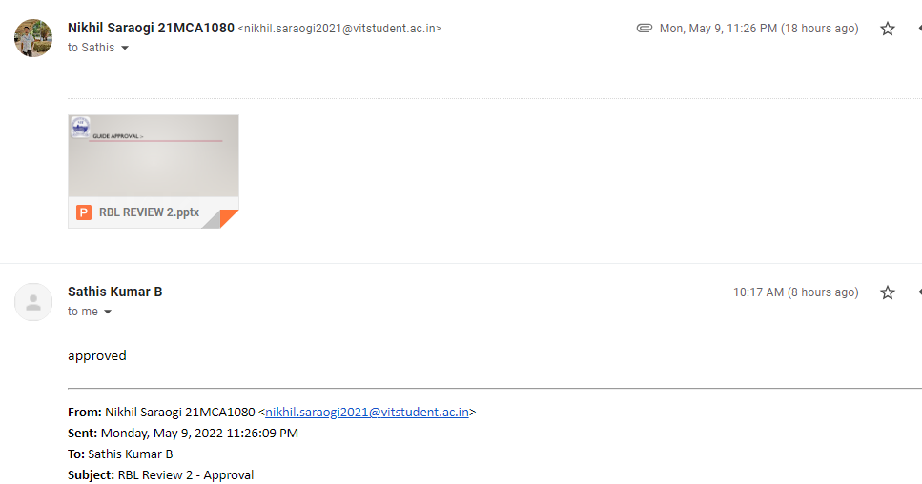
Guide approval :-
VIT - CHENNAI

Slide 2

SCHOOL OF COMPUTER SCIENCE AND ENGINEERING M.C.A. (MASTER IN COMPUTER APPLICATION) 21st SET Conference Under the Guidance of DR. SATHIS KUMAR B
RBL SET 5002
Project – ad or non-ad prediction
Presenter – Nikhil Saraogi 21MCA1080
VIT - CHENNAI

Slide 3
Previous work:-
Project Introduction and aim
Dataset Exploration
Classifiers –
KNN
Gaussian NB
SVM
VIT - CHENNAI

Slide 4
4.) Logistic Regression :-
Supervised learning classification algorithm
Great tool for analyzing binary and categorical data
Independent variable is used to predict the dependent variable
Used to predict the probability of a target variable.
Use Sigmoid Function for probability
Data set should be free of missing value.
VIT - CHENNAI

Slide 5
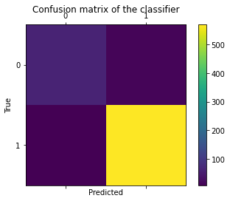
Prediction – logistic regression
RESULTS
F-score: 98.1067%
Mean: 94.8145%
Standard Deviation: 0.8757%
Accuracy: 96.6463%
VIT - CHENNAI

Slide 6
5.) Decision Tree :-
Supervised learning technique
It is a tree-structured classifier, where internal nodes represent the features of a dataset, branches represent the decision rules and each leaf node represents the outcome.
It is a graphical representation for getting all the possible solutions to a problem/decision based on given conditions.
Uses Entropy and Information Gain to construct a decision tree
VIT - CHENNAI

Slide 7

Prediction – Decision tree
RESULTS
F-score: 99.6534%
Mean: 95.9593%
Standard Deviation: 0.8711%
Accuracy: 99.3902%
VIT - CHENNAI

Slide 8
6.) random forest :-
Supervised Machine Learning Algorithm that is used widely in Classification and Regression problems.
Based on the concept of ensemble learning, which is a process of combining multiple classifiers to solve a complex problem and to improve the performance of the model.
Builds decision trees on different samples and takes their majority vote for classification and average in case of regression.
The greater number of trees in the forest leads to higher accuracy and prevents the problem of over-fitting.
VIT - CHENNAI

Slide 9

Prediction – Random forest
RESULTS
F-score: 99.6540%
Mean: 96.9508%
Standard Deviation: 0.8323%
Accuracy: 99.3902%
VIT - CHENNAI

Slide 10
7.) Adaboost :-
Boosting is an ensemble modeling technique (1997)
AdaBoost is short for Adaptive Boosting and is a very popular boosting technique that combines multiple “weak classifiers” into a single “strong classifier”.
Create base learner sequentially
Remove errors after base learner modeling
Base estimator (Decision tree , SVC)
VIT - CHENNAI

Slide 11

Prediction – adaboost
RESULTS
F-score: 97.7021%
Mean: 95.7680%
Standard Deviation: 0.4004%
Accuracy: 95.8841%
VIT - CHENNAI

Slide 12
Conclusion:-
Classifiers | Accuracy
Knn | 98.4756%
Gausian NB | 96.0366%
SVM | 96.6463%
Logistic Regression | 96.6463%
Decision Tree | 99.3902%
Random Forest | 99.3902%
AdaBoost | 95.8841%
VIT - CHENNAI

Slide 13
THANK YOU

